Slide 1
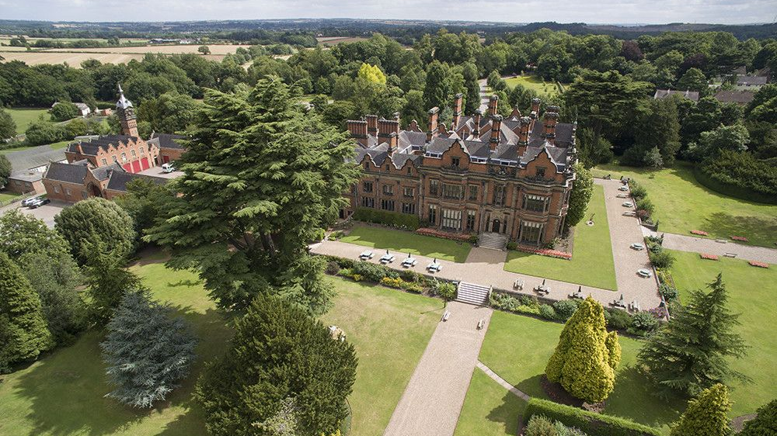

Beaumanor 2025
8 – 11th July
Arrangements for the Week
Parent and Carer Information

Slide 2
E-safety in year 7
Large Whats App groups still exist- please talk regularly with your child about what they are doing online and who they are chatting with. If they do not know all the people in the group, then they shouldn’t be in the group.
Check your child’s privacy settings are set to contacts only and that they have clicked the invite only option so they cannot be added to groups by their friends and end up being exposed to things that are not age appropriate.
Also check they ae not sharing their location.
The next slides may not be suitable for young children

Slide 3
Reminders of the age restrictions
Social media – Whats App, Snap Chat and TikTok – age restriction is 13. If they set up an account in primary school using a false age and the sites “think” they are adults, then they will not filter adult content.
If a child shares a naked image this is sharing pornography and against the law for under 18s-
Some year 7s have a sticker in both their Whats App and Snap Chat that was created whilst at primary school and now do not know how to remove it- these have been reported to the sites but are still showing on pupils phones- please check with your child if they have this sticker.

Slide 4
The Online Safety Act 2023 (the Act) is a new set of laws that protects children and adults online. It puts a range of new duties on social media companies and search services, making them more responsible for their users’ safety on their platforms. The Act will give providers new duties to implement systems and processes to reduce risks their services are used for illegal activity, and to take down illegal content when it does appear.
The strongest protections in the Act have been designed for children. Platforms will be required to prevent children from accessing harmful and age-inappropriate content and provide parents and children with clear and accessible ways to report problems online when they do arise.
Coming soon- More safety checks on a child’s age including facial recognition rather than just text in boxes.
Find out more here: Online Safety Act: explainer - GOV.UK (www.gov.uk)

Slide 5
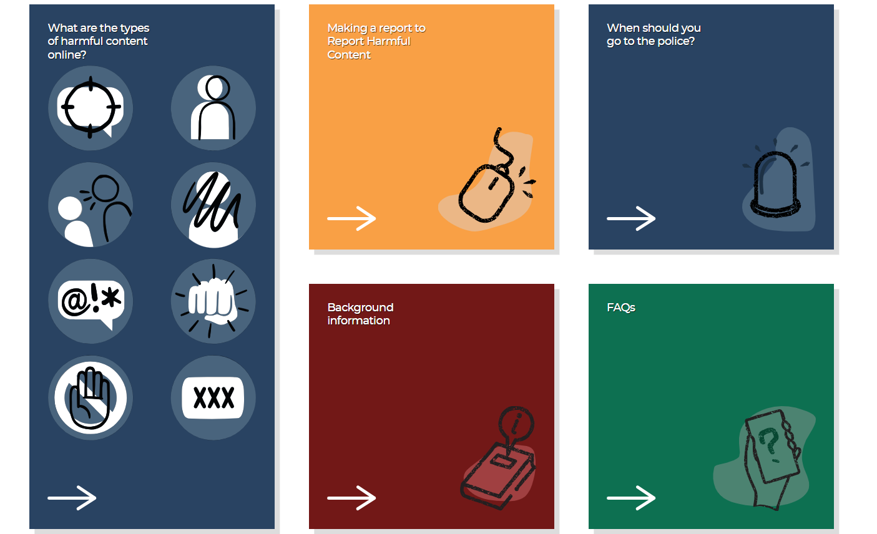
How to report incidents outside of school- Report Harmful Content - We Help You Remove Content

Slide 6

What you can report
Threats
Impersonation
Bullying & Harassment
Self-harm
Online Abuse
Violent Content
Unwanted Sexual Advances
Pornographic Content

Slide 7
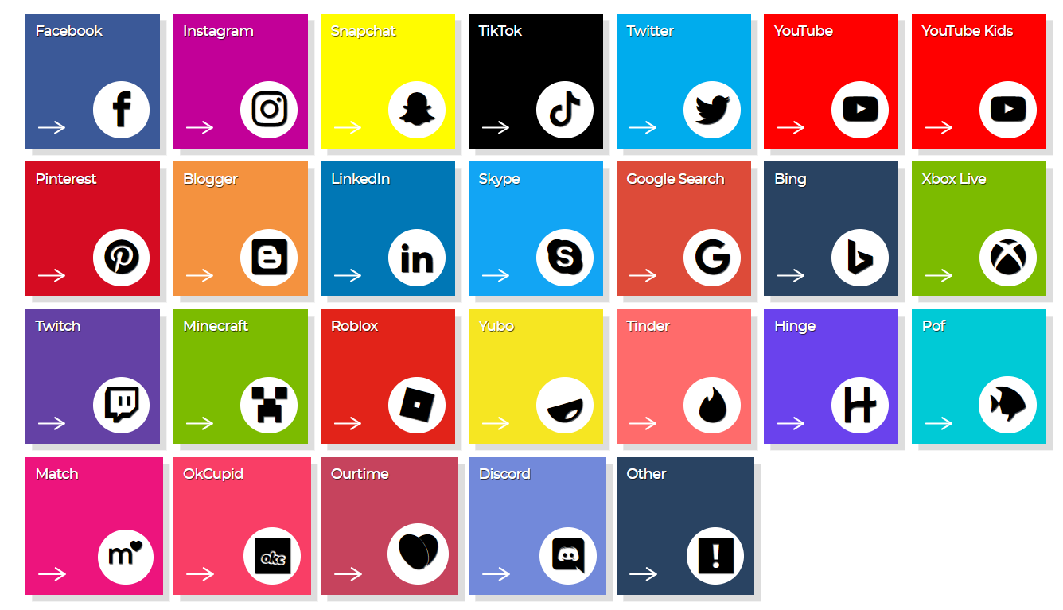
What platforms they work with
Please note WhatsApp doesn’t work with this system.

Slide 8

To report in school
Tell their teacher
Go to the safeguarding office
Email – com-safeguarding
They will then be given support and assistance.
Please note that the safeguarding team can look at a child’s device when concerns are raised and to assist them with privacy settings and reporting to the social media sites.

Slide 9

At Beaumanor they will have a digital detox

Slide 10
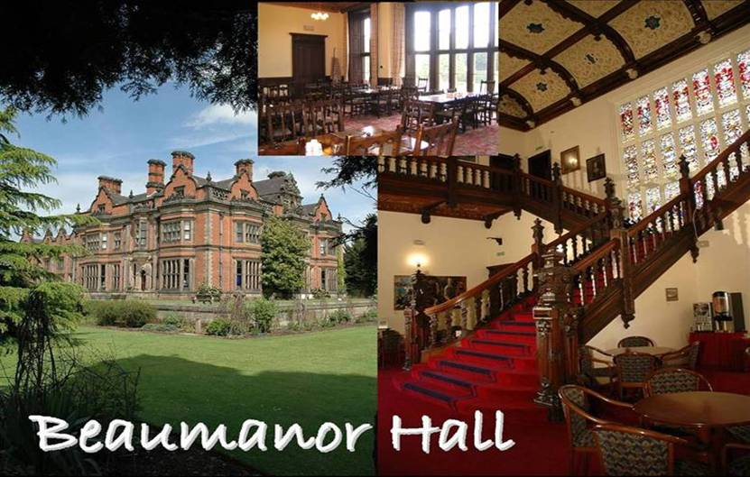
Beaumanor Outdoor Learning Centre
Notes:
Beaumanor Outdoor Learning Centre is Leicestershire County Council’s outdoor education provision.
Some views of the hall, showing the Victorian grandeur of the interior staircase. Also, a shot of the dining hall where the pupils will have their evening meals.

Slide 11
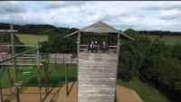
Beaumanor Outdoor Learning Centre
Beaumanor Hall Activities - YouTube
https://www.youtube.com/watch?v=ft9U1z5aAkI
Notes:
Beaumanor Outdoor Learning Centre is Leicestershire County Council’s outdoor education provision.
Some views of the hall, showing the Victorian grandeur of the interior staircase. Also, a shot of the dining hall where the pupils will have their evening meals.

Slide 12
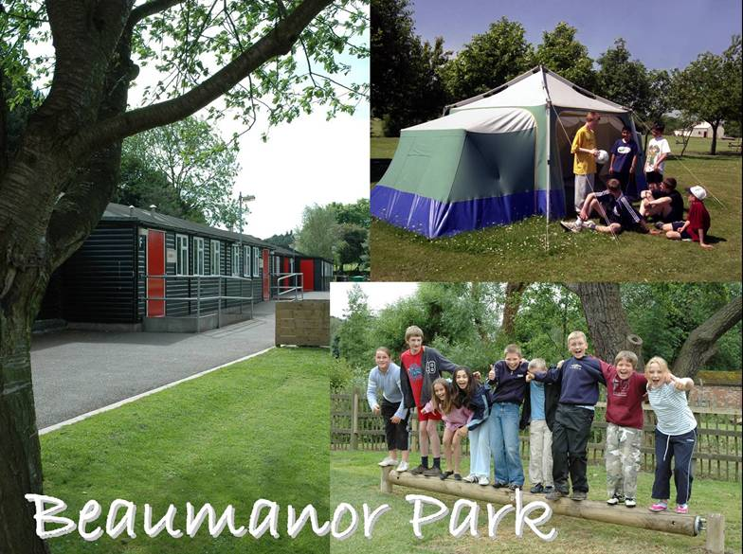
Notes:
Some views of the ‘Park’. A picture of the cabins and the grounds. Sometimes there are campers, so a standing camp is set up in the summer term.

Slide 13
Residential Experience
SOME BENEFITS
Enriches the curriculum
Provides real-world learning
Pupils explore their own potential
Increases self-confidence and resilience
Promotes teamwork and independence
Pupils learn to manage risk
Relationship building
Notes:
The staff at Beaumanor believe passionately in the value of Outdoor Education and the benefits high quality outdoor learning can contribute to a young persons education. We will always try and work with schools to ensure the experiences we deliver to young people make a positive contribution to the school based curriculum.

Slide 14
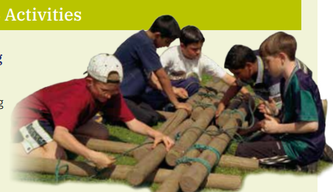
Team Activities
There are a series of team building activities designed to familiarise the group with the staff and site, preparing them for challenge, adventure, working together and fun.
Notes:
This is a series of team activities designed to familiarise the group with the staff, site and what lies ahead, preparing them for challenge, adventure, working together and fun.

Slide 15
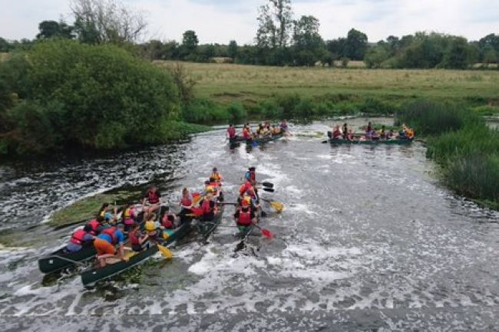
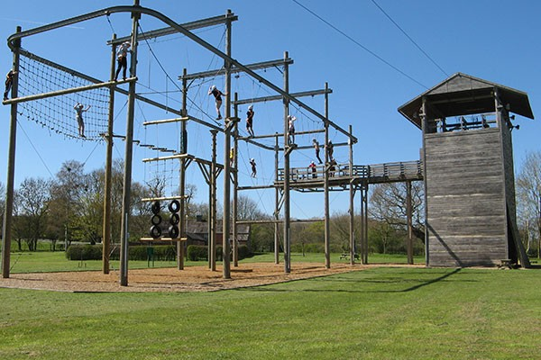
Main Activities
Notes:
This is a series of team activities designed to familiarise the group with the staff, site and what lies ahead, preparing them for challenge, adventure, working together and fun.

Slide 16
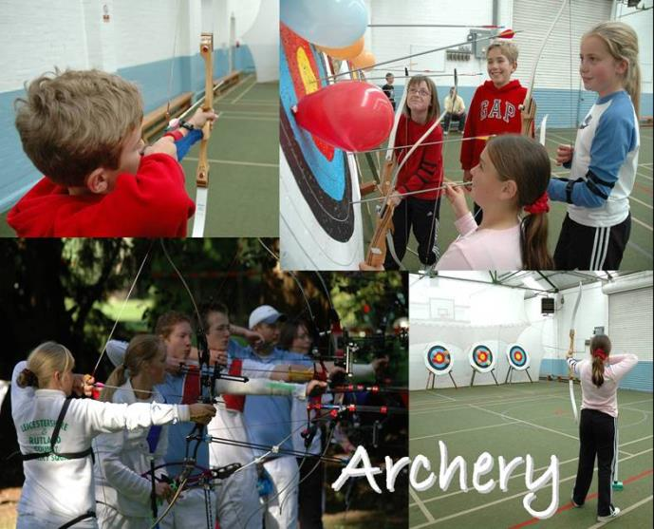
Technical skills
Knowledge
Games
Team competition
Life skills
Notes:
Beaumanor has both indoor and outdoor archery ranges.
All instructors have been CRB checked. All instructors have relevant National Governing Body qualifications to be able to deliver the adventure activities.
The activities your children will do:
Archery

Slide 17
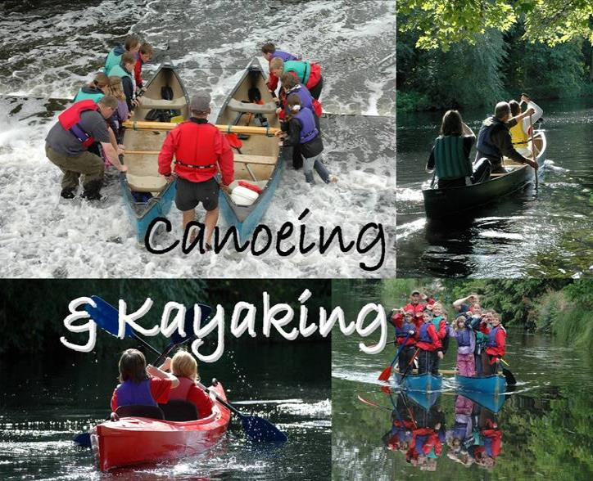
Technical skills
Knowledge
Teamwork
Journeying
Challenge
Notes:
Canoeing is based at Proctors. You will be taken there by minibus.

Slide 18
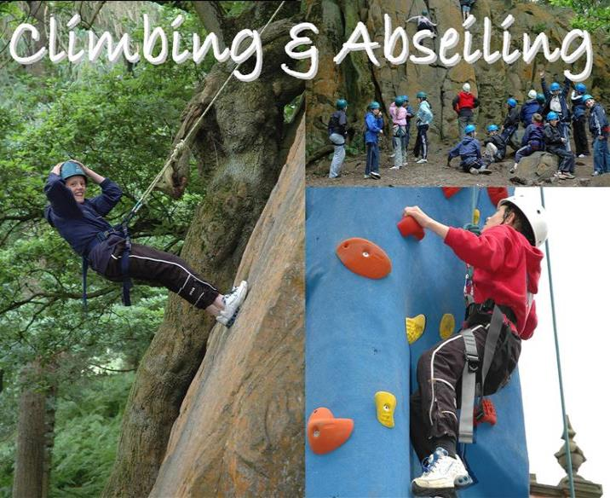
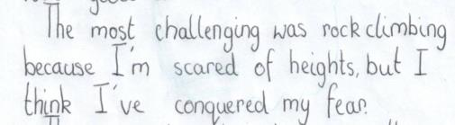
Technical skills
Knowledge
Safety
Personal Challenge
Life skills
Notes:
Climbing can take place on the indoor wall or on the walls on the High Ropes Tower. Children learn the basics in climbing and may do some paired belaying, where they support each other. This activity requires both believe in oneself and trust in others.

Slide 19
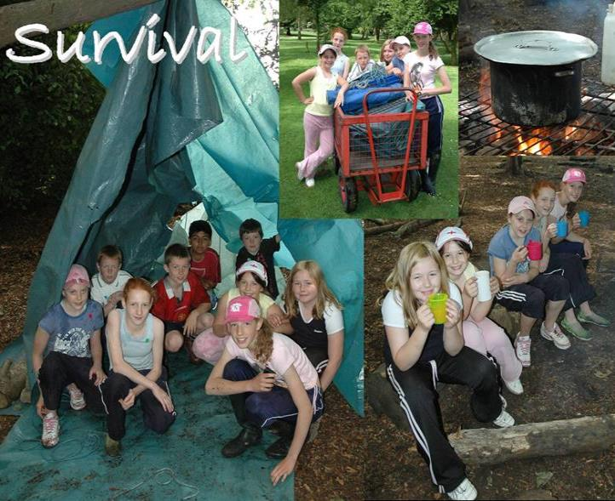
Problem Solving
Safety
Teamwork
Life skills
Knowledge
Achievement
Notes:
The children will be given the task of building a water-tight shelter in the woods at Beaumanor. Their instructor will throw a bucket of water on to their shelter to see how successfully the task has been completed. The activity calls upon students design skills and the ability to work as part of a team. The essentials for survival will be explored and how these requirements might be met.
They will then have some soup around a campfire.

Slide 20
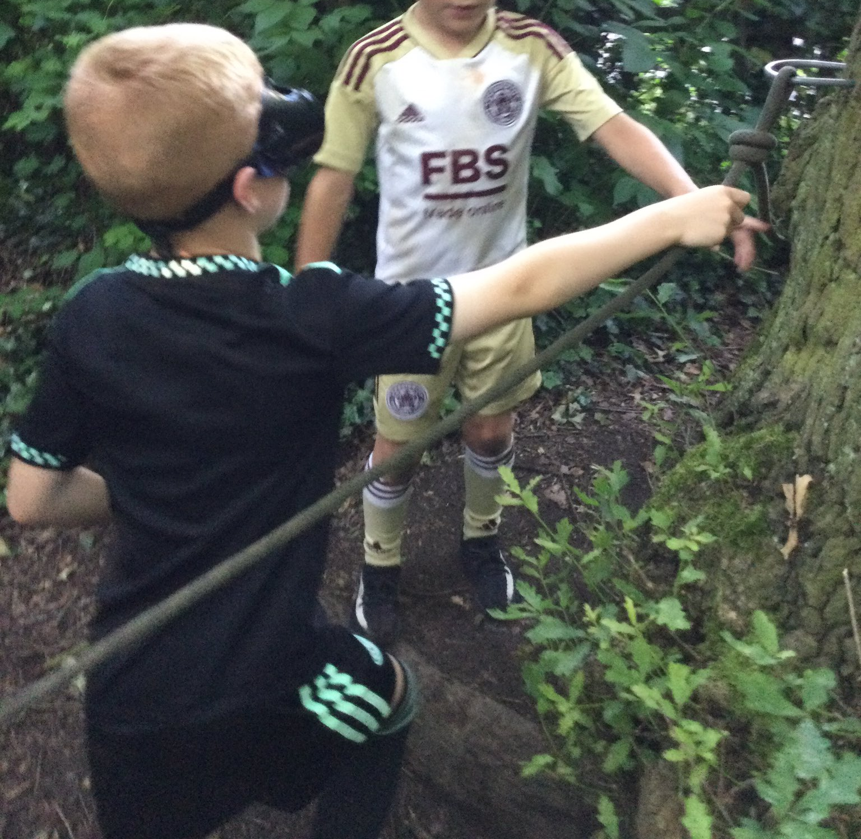
Nightline
Teamwork
Trust
Sensory exploration
Communication
Problem solving
Fun

Slide 21
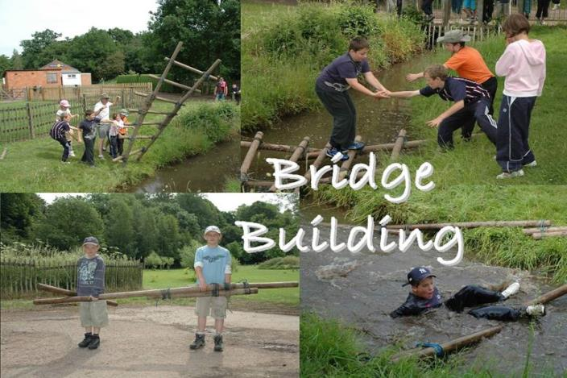
Problem Solving
Safety
Teamwork
Life skills
Knowledge
Achievement
Notes:
Working in small groups will construct a bridge consisting of wooden poles and ropes. The bridge is then used to cross the stream, ideally without without falling in!
They will be taught a selection of knots and lashings to enable them to build safe structures.
It is an exercise calling for leadership, co-operation, planning and design skills.

Slide 22
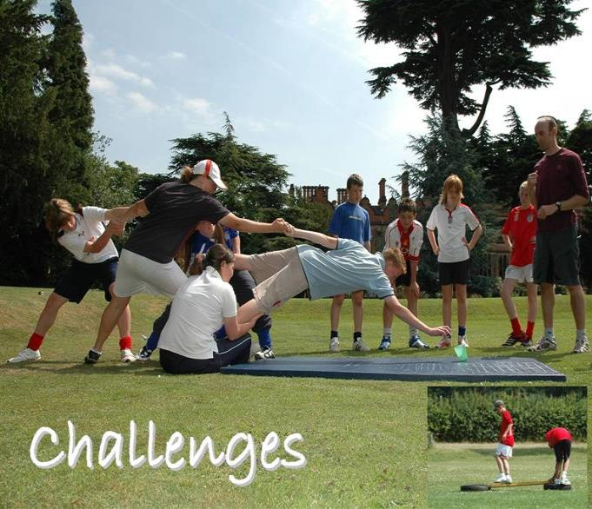
Problem Solving
Safety
Teambuilding
Life skills
Knowledge
Achievement
Notes:
The group will take part in a series of challenges that will help them use their team working skills. This is physical and mentally challenging session.

Slide 23
Safety
Personal Challenge
Life skills
Thrill
Achievement
Notes:
The young people ( and group leaders!) will be encouraged to attempt the aerial trek, an obstacle course 6 metres off the ground, and have a go on the zip wire. This is an exhilarating experience and the participants will gain a great sense of personal development from this.

Slide 24
FAQs

Slide 25
Q. Do I have to camp in a tent?
A. No, but most pupils will!
Part of the fun for most pupils (and many staff) is camping for the week; therefore, we anticipate that most pupils will do so.
However, there are cabin/dorm spaces available for our pupils who have additional needs.

Slide 26
Q. If camping, who do I camp with?
This is up to you, but there are a few rules.
- We are asking that you camp in a group of three.
- We are asking that you have a four-person tent, so there is enough space to store your belongings.
- Groups must be of the same gender, but they can be from any form
- You need to have practiced putting up the tent by yourself (staff will help, though).
- You will need to provide your own tent
- Assistance with sourcing a tent may be possible in some cases if no one in your group of three has one.

Slide 27

No phones at Beaumanor
To improve wellbeing
To promote new friendships
To ensure no images are taken without permission
To encourage students to enjoy the beautiful environment in which they are in.
A digital detox from the reliance of their mobile phone.
E-safety is of paramount importance, and there would be no way for us to monitor this in the evenings.
If you need to contact them there will be a number for a member of staff, you can use in an emergency. If we need to contact, you regarding your child e.g. they become ill then rest assured we will do this, and you will be asked to come and collect them.

Slide 28
Q What will happen on Monday?
Activities in Beaumanor groups but in school
- History of Beaumanor
Designing t-shirts
Practice putting up your tent, bring it in on the Monday
Team games

Slide 29
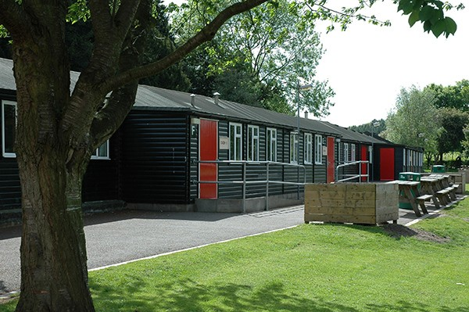
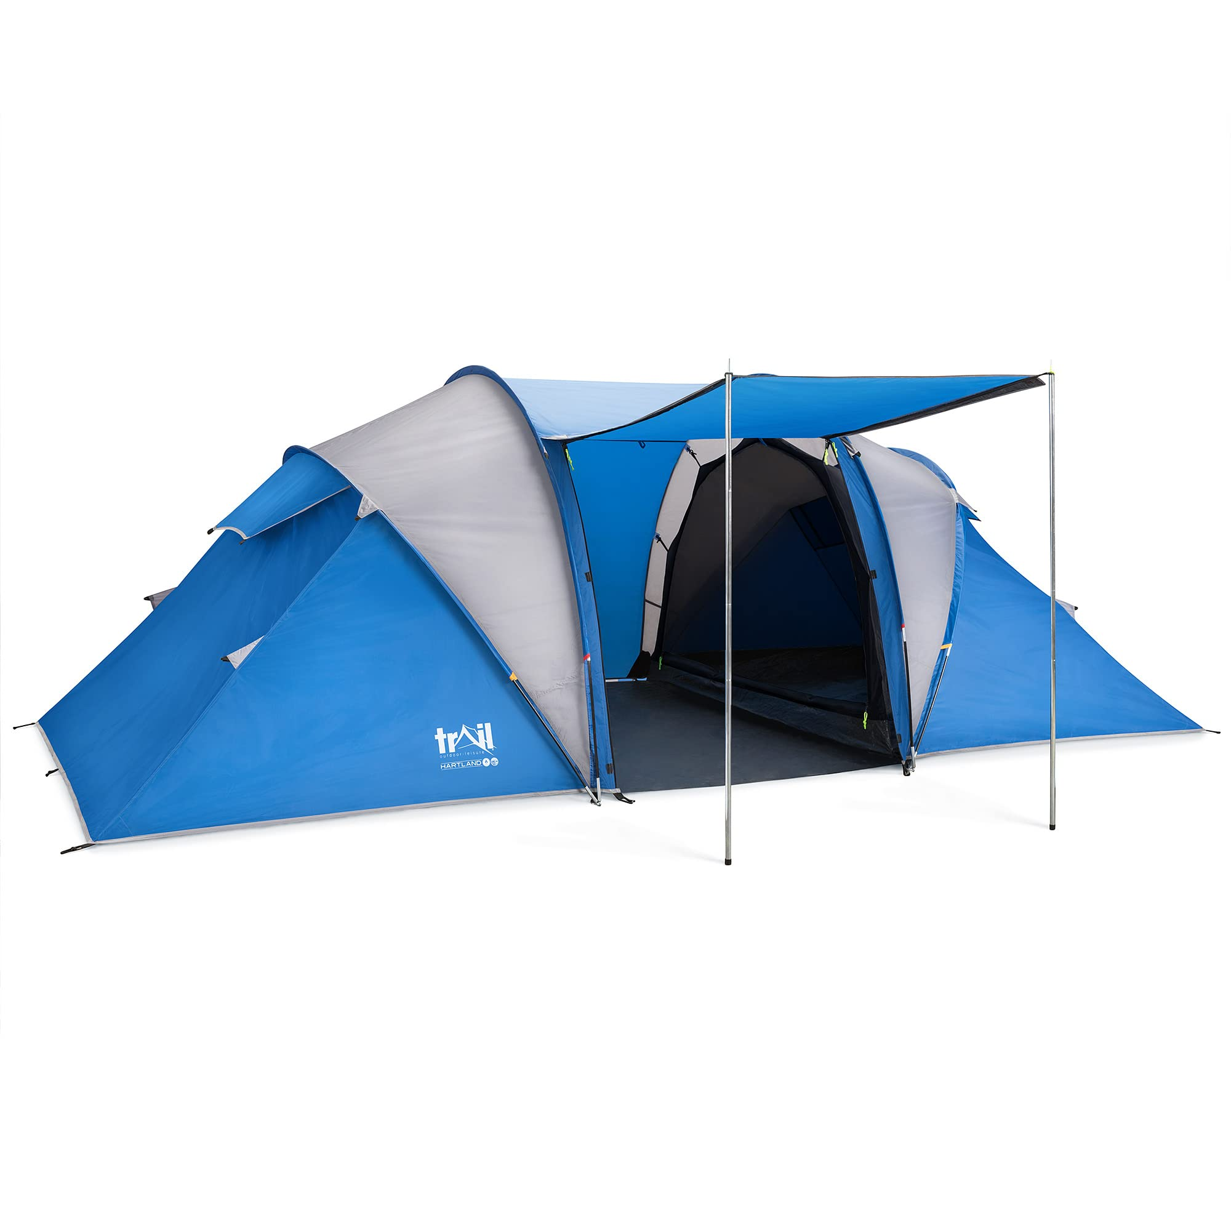
Accommodation

Slide 30
Tents
- 4-person tent, with 3 pupils sharing
- Space for pupils and belongings
- We’re limited to how much equipment the coach can carry
- Bring your tent in on Monday for us to practice putting it up. We will then keep it in school and put it on the coach on Tuesday for you.

Slide 31

What are Meals Times Like?
There are breakfast and dinner sittings. The sittings are organised based on their groups and it is important that students go to the correct sittings due to kitchen organisation and dietary requirements.
Breakfast:
Cooked breakfast options available.
Cereal, toast, juice etc.
Breakfast is a sitting, in the main hall.
Lunch:
Packed lunch with a variety of sandwich options, fruit, crisps and snacks.
Dinner:
Variety of dinner options throughout the week including pizza, sausage and mash, meatballs and pasta, burger and chips.
All meals are served with vegetables and desserts include fruit and yoghurt.
Dinner is a sitting, served in the main hall.
Vegetarian options/alternatives are available for every meal served.

Slide 32
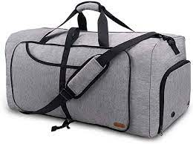



Packing and Kit
Residential kit
The tent!
Sleeping bag
Pillow
Camping mat (no inflatable air beds)
Towel
Toiletries (e.g. shower gel, shampoo, toothpaste, toothbrush)
Underwear (plus spares!)
Torch
Nightwear
Trainers
Indoor shoes (e.g. sliders, dry trainers)
Sun hat
Sun cream
Plastic bags
Clothes for around site (non-activity clothes)
Bags:
Everything should fit in one bag/holdall that the student is able to carry themselves.
They may wish to bring a small rucksack for the coach and for when they are out on activities.
Optional Items
Playing cards or top trumps for the evenings
Gift shop money
Outfit for the disco
Top tips!
Name everything! Including the bag!
Student should practice packing their bag (for the return home)
Bring carrier bags (for wet and muddy clothes!)
Students should pack their own bags, so they know where everything is when they arrive at Beaumanor!
Make sure you pack clothes for the disco!
Kit for activities
Tops/light weight t-shirts
Thermals or leggings/tracksuit bottoms/shorts
Sweatshirt/jumpers/fleece
Waterproof jacket
Waterproof trousers (optional)
Hat
Old trainers (that can get wet and/or muddy)
Wet shoes for canoeing (optional)
Personal protective equipment such as helmets and harnesses are provided.
Reminder:
We are going for a digital detox approach to Beaumanor!
Students should not bring their mobile phones with them.
Staff will have phones to contact home in an emergency

Slide 33
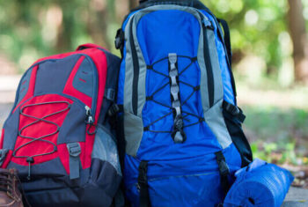
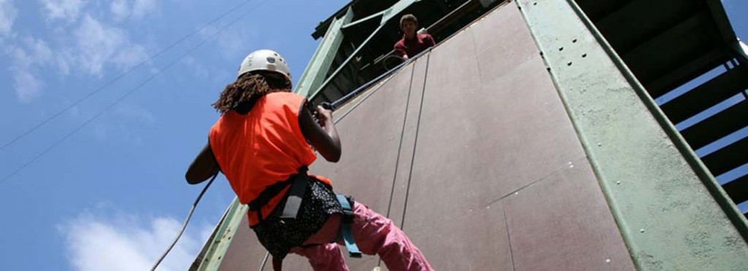
Residential Kit
Sleeping bag
Roll matt
Pillow
Toiletries
Towel
Nightwear
Underwear
Torch
Indoor shoes
Sun cream
Plastic bags!!!
Gift shop money
Warm clothes for the evening
Bag for around the site
Playing cards, top trumps or similar for evenings
Notes:
Suncream:- we recommend factor 30 as a minimum requirement.
A rucksack is a good way to carry the sleeping bag – pack sleeping directly into the rucksack.

Slide 34
Kit for Activities
Recommended kit. No jeans for activities. They hold water when wet and do not dry off quickly enough.
No expensive clothing or fashion items. The clothes will get dirty, muddy, wet and smelly so old or not so special clothes are best
Tops/light weight tshirts
Tracksuit bottoms/shorts/leggings
Thermal or warm clothes for the evenings
Sweatshirt / fleece
Waterproof jacket / trousers
Hat
Old trainers that can get wet canoeing
Trainers
Wellies or sturdy boots
Beaumanor provide personal protective equipment
Notes:
All specialist equipment is provided such as helmets and harnesses and children are shown how to put them on. Instructors always check that it is fitted correctly before the children start any activities.

Slide 35




What does a typical day look like?
Throughout the week, we will be doing all kinds of activities! These include archery, climbing, high ropes, canoeing, abseiling, bush craft, nightline, orienteering, bridge building and zip line!

Slide 36
What does a typical day look like?
Time | Event
7.15 – 9am | Breakfast sittings
9.15am – 12.15pm | Activity 1
12.15-1.15pm | Lunch
1.15pm – 4.15pm | Activity 2
4.45 – 5pm | Assembly
5.30 – 7.15pm | Dinner sittings
6.30 – 9.30pm | Evening activity (some days, for some groups)
9.30 – 10pm | Hot chocolate
10pm – 10.15pm | In tents, lights out at 10.15pm
There will be a briefing each day at 9am – 9.10am and then at 4.45pm-5pm. These will be held outside or in the Sport Hall if there is bad weather

Slide 37
Evening Activities
Cellars – Hide and Seek
Night Line
Football and outdoor games
Final night talent show and disco!
Notes:
There is a small selection of evening activities form which the school will have selected:
Murder Mystery:
The group will do MM around the site, looking for clues to solve a mystery, inspired by the Victorian history of the house.
Cellars:
The group will play ‘Hide and Seek’ in the cellars. The session starts with some lights on, which are gradually dimmed. This activity enables children to overcome a fear of the dark This activity is usually a highlight of the trip.
Gym Games:
The children will play a selection of sport games in the gym or on the field – light and weather depending!
Campfire:
The children will sit around a campfire and play a few games. Visiting staff are more than welcome to lead singing round the campfire!
Night Line:
The night line is a rope trail running through our beautiful woodlands across numerous man-made obstacles. Participants follow the course blindfolded, meaning that other senses (and perhaps good communication from a sighted helper) must be relied upon to enable a safe and successful circuit of the course.

Slide 38
Illness Prior to the Trip
This is a reminder that if a student has a temperature, vomiting or diarrhoea less than 48 hours to the leaving date, they should not attend the trip.
To ensure they are well enough to attend, they should be symptom free for 48 hours.
If this does occur, they can be dropped off at Beaumanor after their 48 hours if they wish to join after this period of time.
****
As with any absences, please contact the school via the main school phone line to let us know, prior to 8.30am.
We will have a medically trained professional accompanying us on the trip who will oversee medication and be on hand in case of emergency.

Slide 39

Thank you for listening
Any Questions…?
Ms Phull, Head of Year 7
rphull@combertonvc.org
Ms Moi, Year 7 Administrator
EWojtowicz-Moj@combertonvc.org

